Slide 1
Making the Case for
Investing in Active Aging
Notes:
This slide deck is meant to provide you with visual resources to help encourage your community, organization, volunteer leaders and professionals to address the emerging new age cohort of those (approximately) between 55-80, most of whom are empty-nesters, still healthy and eager to have a productive and enriching role in the world. We call this new because once upon a time, there was a gap in the Jewish community’s attention to those between mid-life career and retirement. That “once upon a time” is over and so we must focus on this cohort as we have on young adults or children or families if we want to sustain and nurture a healthy Jewish community and engage this vital (and large) group in Jewish and civic life.

Slide 2
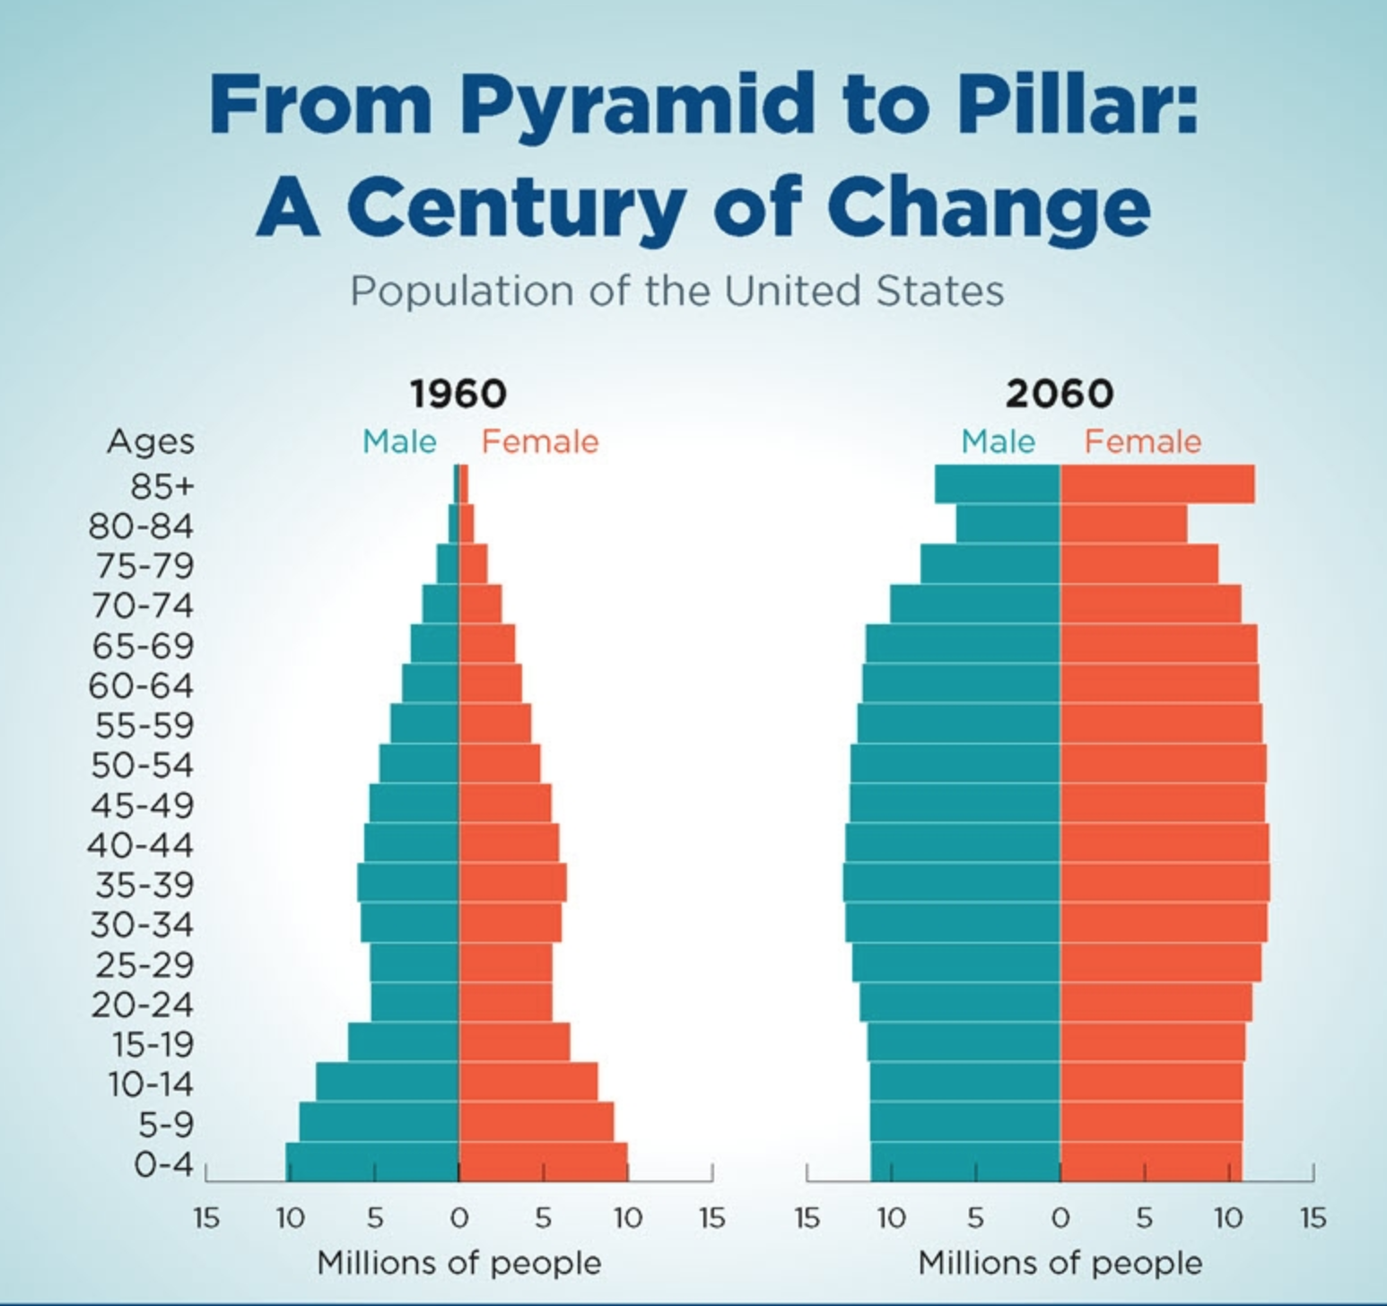
Notes:
This is in some ways the most important slide from recent Census.Gov findings. For millennia, the population pyramid was a pyramid –featuring many young people and narrowing as people age. But that has radically changed – and is even more pronounced for Jews (who skew older than the general population.) Dr. Laura Carstenson of Standford’s Center for Longevity calls this the “evening out of the age pyramid” and a key reason for increased age diversity. As a result, to not address the needs and desires of our growing aging population – especially since research shows that relatively few of them are in need of geriatric institutional care - is counterproductive and risky, and ignores the major trends noted here.

Slide 3
Notes:
This simple chart makes the point that those over 65 make up the largest cohort within the Jewish population followed by the next age-and-aging cohort (55-64). Many of these older Jews are very vital and searching for their path forward even as they move toward or through retirement. We also know that a significant portion of those over 65 will continue to work, not so much because of financial demands, but in their search for life meaning and purpose, or simply to do interesting things (Jewish Virtual Library)

Slide 4
Baby Boomer Characteristics
Top 5:
Respectful 45%
Work Centric 36%
Community oriented 33%
Tolerant 30%
Well educated 30%
(2019 Ipsos Global Trends across all age groups; % of total sample)
Bottom 5:
Selfish 8%
Tech-savvy 6%
Trendsetters 6%
Narcissistic 5%
Lazy 4%
Notes:
This is a most interesting slide. Baby Boomers – meaning those born between 1946-1964, those who are now between 58 and 75 -- are viewed very positively (especially in contrast to other age cohorts) in terms of some admirable civic traits. We need to capitalize on the positive here, to make sure that they are connected Jewishly to our institutions where they can help strengthen these institutions and set an example for others.
(SOURCE: Duffy, THE GENERATION MYTH, 2021)
% of total sample which spans all adults

Slide 5
Boomers as ACTIVE Citizens
Boomers Have the Highest Volunteer Rate of Any Age Group. The volunteer rate for boomers — 33.2% —is more than four percentage points above the national average of 29%.
Boomers Volunteer an Average of 51 Hours a Year.
They are most likely to engage in those activities that make use of their talents, skills and life experience.
Volunteering is the best way to engage people in an organization’s work—and support
Notes:
The third point is crucial: Volunteering is not about stuffing mailings. Research provides very clear evidence that Boomers want to participate in society and improve it; many are civic minded and seek meaning in their lives. Many non-identifiably Jewish organizations and groups would love to have Jews as volunteers (just ask all the major universities and hospitals – as well as the local YMCA’s.) If we want them to engage in Jewish organizations and organizing efforts and not go elsewhere, then we must focus on the talents, skills, education and experience they bring—and find ways to connect with them and capture their interest.
(Source: Duffy, THE GENERATION MYTH, 2021)

Slide 6
The Extraordinary Rise of Older Workers
The work force in the United States has risen by 22 million since 1998.
90% of the increase is due to higher employment levels of workers 55 and over.
A key component of this change is that a greater proportion of older individuals are
staying in or re-entering the workplace by “unretiring”.
This change is particularly striking among older women.
(Grayton and Scott, The 100 Year Life)
Notes:
We can no longer assume that Jews will retire at 60 or 65 and we know that Jewish women, highly educated and experienced, will remain in the workforce as well. So, offering programs at 10 in the morning will not entice the aging population. We need to rethink what Jewish engagement will look like if we want to keep aging seekers in the Jewish community because they have the resources and experience to look elsewhere. And that is exactly what they are doing.

Slide 7
LIFE SATISFACTION
In a European survey, life satisfaction results revealed a “U-shaped curve” based on a 4.0 scale that controlled for health and wealth; note that satisfaction rebounds as people enter their late 50’s:
Highest positive was age 16 at 3.28
Satisfaction declined uniformly to a low of 2.90 at age 55
Satisfaction then rose uniformly to 3.07 at age 65 and 3.2 at age 84
USA results would likely be similar if we removed those affected by depths of
despair, i.e., low satisfaction of poor non-college Whites;
SOURCE: Blanchflower Eurobarometer 2009-2019
Notes:
Aging is no longer the frightening end-game brought on by retirement at 65. In fact, we have increasing evidence that our aging Jewish population wants to age in place. Imagining twenty-five to thirty-five additional years to experience new things and to find and pursue new opportunities for meaning is seen as a positive opportunity by many. This is positive energy that we can capture, deepen and share. Or miss out on.

Slide 8
Notes:
After World War II, the Depression and War Generations (those born before 1946) typically moved to the suburbs, joined the synagogue and attended services not just to pray, but to be social and part of a Jewish community. In contrast, the next generation(s), starting with Boomer, often chose a different path. Increasingly, synagogue services are not necessarily where Jews will be found –in fact, for many, membership in virtually any institutions has lost its appeal. But the synagogue, just as the JCC and other settings, can offer multiple experiences that can engage (or re-engage) this group in Jewish life and keep them coming back. In this sense, “Jewish” is what Jews do – and that can be volunteering at a soup kitchen or gathering at half-time in a “Jewish” box at a football game...or learning together, in person or online.

Slide 9
Notes:
These recent data provided by Prof. Janet Aronson of the Cohen Center at Brandeis University tell us that the very age cohort on which we are focused is actually less engaged than younger people. These older Jews’ children have grown and left the household, thereby removing a major motivator many had for joining the synagogue or acting communally; for many, now that they are empty nesters, the next “need” they may have for the organized Jewish community would be related to end-of-life issues. That means that there are a lot of years in which we either step up and provide meaningful activities or lose their participation and interest. Otherwise, as stated before, they will go elsewhere.

Slide 10
Notes:
While this data set is from one community, it is fair to assume that we could see similar results regarding engagement across the continent – while families with children in school and even singles seeking community show substantial engagement in communal and immersive affairs and activities, older cohorts respond that they have a personal (as opposed to communal) connection to Jewish life. That distinction comes at a cost not just in the numbers of participants, but in funding - a decreasingly engaged older Jewish population means a significant loss of income for our institutions.

Slide 11
Notes:
What our synagogues and institutions know (or need to know) is that we have not returned to pre-pandemic physical engagement: those that provided on-line virtual services and programs are being asked to retain those programs or at least to provide a lower-cost hybrid offering. What’s more, most on-line offerings are not subscription only (for instance, it is very easy to get the URL for High Holiday services). Again, this has huge financial implications as well as a challenge to sustain a nurturing, active and connected (in real life) community.

Slide 12
A Vulnerable Population
In all of the regional Jewish communities B3 surveyed over the past decade, Boomers and Empty-Nesters showed the same signs of weak fidelity often associated (or feared) with younger Jews – about half question their affiliation with synagogues, even more with other organizations such as JCCs and Federations—and they express readiness to look elsewhere for whatever it is they want at this time.
Notes:
And so, we see the cost of neglect and lack of focus on the active aging population. In our research, we identified a significant portion of Jewish members of institutions who are questioning their membership or continued participation – and this was before the pandemic. The difference between the prior War Generation and later cohorts is very significant and we cannot rely on past affiliation patterns to predict the future. Every marketer knows—or at least learned the hard way—that this Boomer generation will go its own way to find whatever it wants at the moment it wants it. For many, fidelity is not a given—but wanderlust is. We have seen this in secular institutions, too. It is part of the same cultural landscape in which episodic engagement is the norm and people will be content to graze until they find what they want—and then will move on again.

Slide 13
Crossing Generational Divides
A number of books with titles like The Theft of a Decade: How the Baby Boomers Stole the Millennials’ Economic Future or How the Baby Boomers Betrayed America have been published in recent years.
Yet, following recent surveys, there is little sign of a coming “generational war.” Most obvious are our family connections and the fact that we inevitably pass through each age range ourselves.
Cross-generational programming that consciously includes those in the vital aging population makes sense and builds stronger connections.
The Generation Myth by Bobby Duffy (2021)
Notes:
The good news is that getting a handle on how to nurture the active aging Jewish population is good for the whole Jewish community. Boomers are remarkably similar to the succeeding age cohorts in terms of education, life experience (no world war, no Depression, no Holocaust) and enjoy comfortable integration into North American life. So, to address the needs and aspirations of the Boomer and broader active aging population is to forge the path of affiliation and meaningful engagement for future generations as well.
Seeking cross-generational engagement makes sense.

Slide 14
A Clear (Cognitive Health) Benefit to All: Active Aging
“This idea that old age is associated with only declines is not true,” said Dr. Dilip Jeste, a psychiatrist who has studied aging at the University of California, San Diego. “There are studies that have been done all over the world which show that in people who keep active physically, socially, mentally and cognitively there is increased connectivity among specific networks, and even new neurons and synapses can form in selected brain regions with older age.”
New York Times 11/20/22
Notes:
Countless studies and articles have explored the health benefits of active aging—of social connections, of volunteering, of exercise and more…and the emotional and physical difficulties caused by isolation. Investing in active aging programs not only promotes stronger connections within the Jewish community but also promotes better health among participants.

Slide 15
Successful Active Aging Program Models are Being Imagined and Introduced
Visit activeagingnetwork.org for examples
Programs are being created by federations, including community-wide listening tours and task forces, and by JCC’s, synagogues and organizations
“One-stop” centers for aging are raising visibility for new programs and revealing increasing investment in these programs (see the Wechsler Center for Modern Aging at the Mayerson JCC Manhattan and the Cummings Centre in Montreal)
Many federations are introducing AgeWell initiatives
Synagogues are exploring new approaches to engaging people as they move into this life stage (see LabShul’s GENerate multi-year program)
Other communities are exploring residential strategies (see LA’s ChaiVillageLA and Boston’s 2LifeCommunities)
The Jewish Grandparents Network is connecting people to their grandkids and to Jewish learning and experiences
Notes:
Innovation is happening in the U.S., Canada and beyond as communities and organizations explore new models of active aging engagement. Activeagingnetwork.org was created to gather these examples—and more—and help groups benefit from the learning and insights achieved by early innovators in this field. The site also hopes to ignite new partnerships as groups around the U.S., Canada and beyond team up to learn from each other—and inspire each other.

Slide 16
Active Aging Engagement—Time to Start
A large, active segment of Jewish adults is under-served
As they approach the end of their mid-life careers and proceed toward or into retirement, they are open to new pursuits
Jewish communal engagement can be part of these new pursuits—as long as programs, content and positioning are relevant and timely
If not? This group has always shown it will go elsewhere
Groups around the country are recognizing this opportunity to strengthen Jewish life, so new models and programs are being created
What will your community do to capture this important group?

Slide 17
Time to Imagine and Implement an Active Aging Program
Check out activeagingnetwork.org for resources and connections to other organizations and individuals interested in active aging in Jewish life
Or reach out to B3 through the active aging website

